Slide 1
Project1 : e-Menu
Sai Deepika
Tejaswi Eerpina

Slide 2
Problem Statement:
Our aim is to increase the revenue of a food truck by creating an online Menu of their delicacies.
People can order online which saves time. Many offers are provided to make the dining experience rewarding.

Slide 3
Requirements
Front-End : Developed in HTML, CSS.
Web Browsers : Google Chrome, Firefox, Safari, Edge etc.
IDE : Notepad++, TextWrangler.

Slide 4

Welcome Page

Slide 5
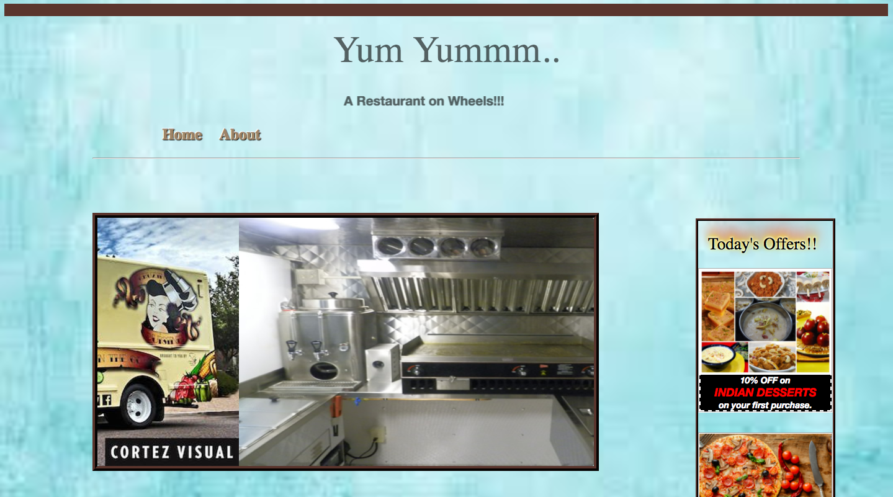
Main Page

Slide 6
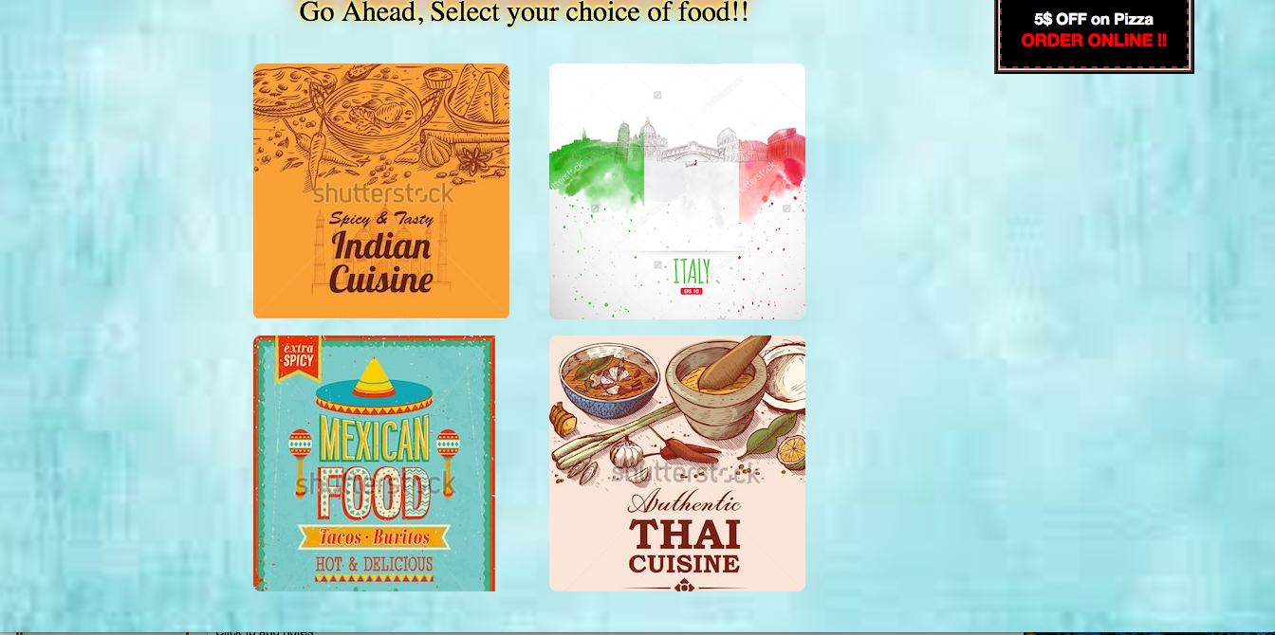
Main Page (Continued..)

Slide 7
Code snippet-div animation
.circular1 {
width: 270px;
height: 270px;
border-radius: 8px;
-webkit-border-radius: 8px;
-moz-border-radius: 8px;
background: url(india.jpg) no-repeat;
transition: all .2s ease-in-out;}.
circular1:hover{transform: scale(1.3);}

Slide 8
Code snippet –image movement
/* configuring positions for slide animation*/
@keyframes slider {
0%, 10% {margin-left: 0;}
15%, 25% {margin-left: -100%;}
30%, 40% {margin-left: -200%;}
45%, 55% {margin-left: -300%;}
60%, 70% {margin-left: -400%;}
75%, 85% {margin-left: -500%;}
90%, 99.9% {margin-left: -600%;}
100% {margin-left: 0;}}
.slider li:first-child {
animation: slider 20s ease-out infinite;
-webkit-animation: slider 20s ease-out infinite;}
/* pause animation on mouse over */
.slider:hover li:first-child {
animation-play-state: paused;
-webkit-animation-play-state: paused;}

Slide 9
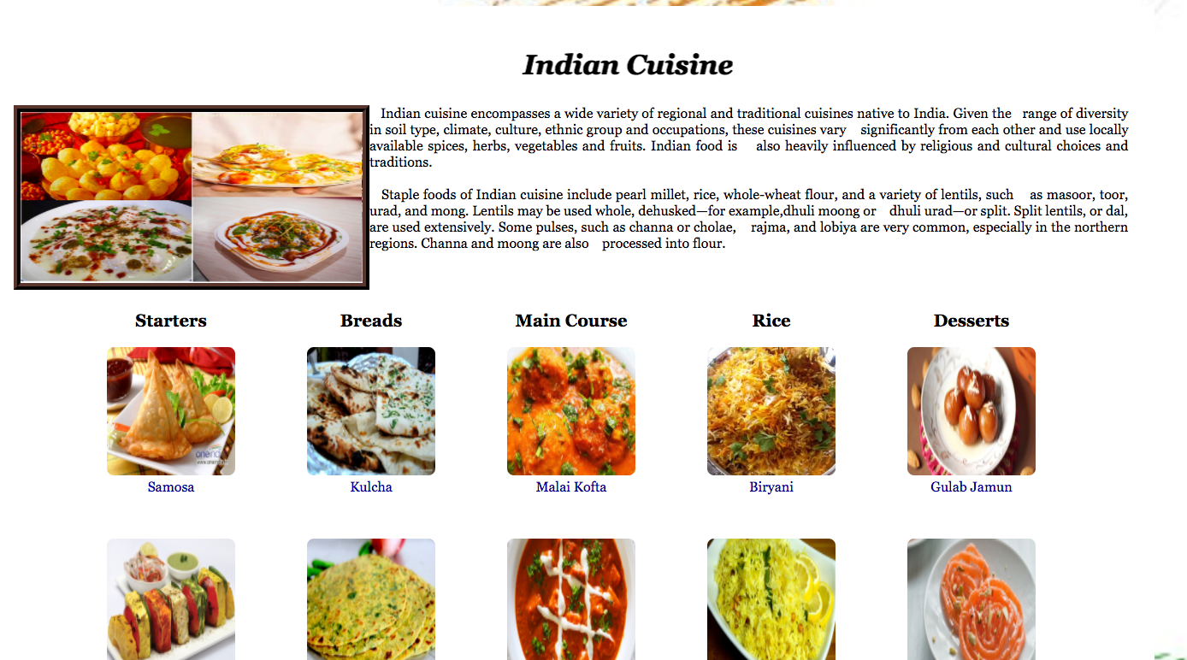
Indian cuisine

Slide 10
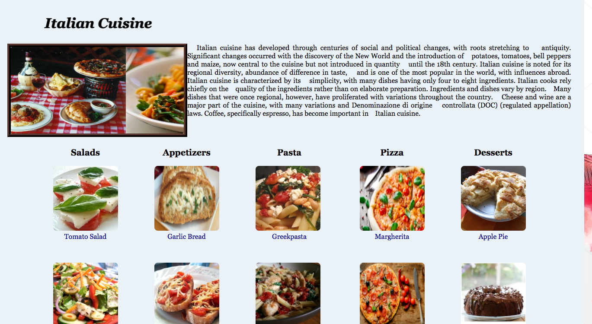
Italian Cuisine

Slide 11
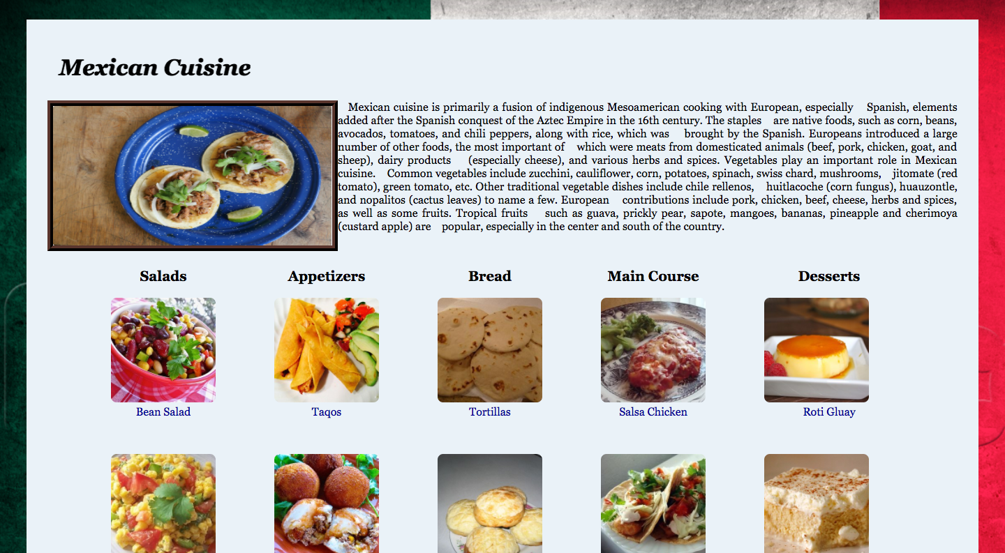
Mexican Cuisine

Slide 12
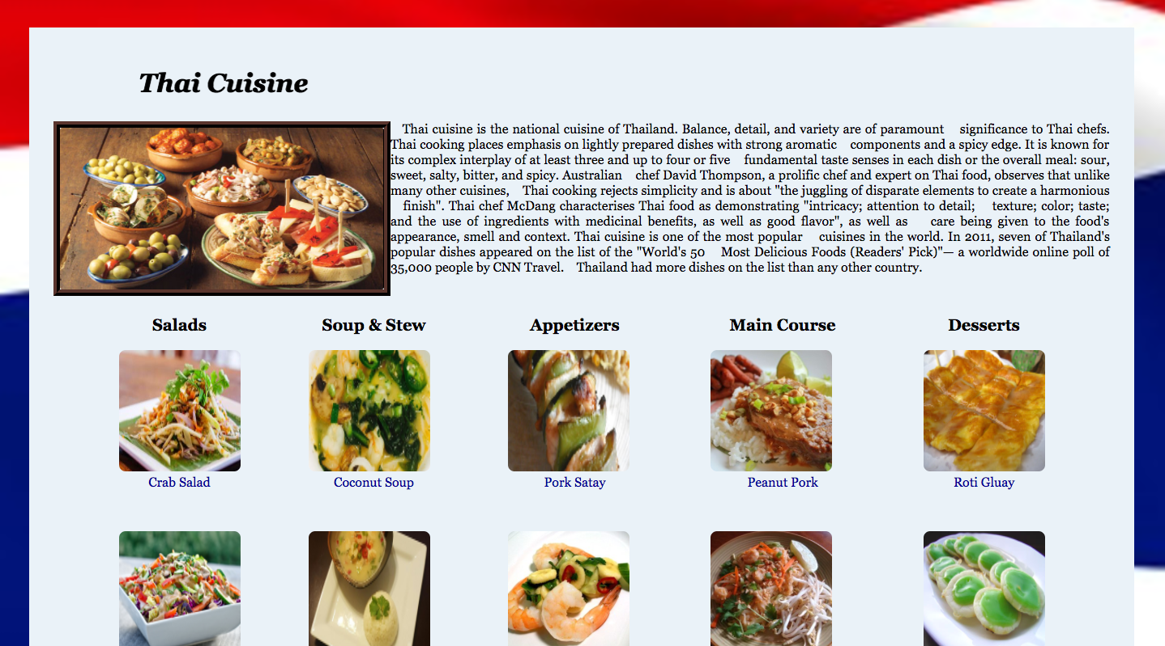
Thai Cuisine

Slide 13
Code Snippet : CSS
html#Indian{
background-image:url("background1.jpg");
background-size:cover;
background-repeat:no-repeat;
padding:30px;}
.pimg{
height:150px;
width:150px;
margin-left:auto;
margin-right:auto;
border-radius:8px;
-webkit-transition: width 2s, height 2s;transition :width 2s, height 2s ease-in-out;}.
pimg:hover{transform : scale(1.2);}

Slide 14
QUERIES??

